Slide 1

PYTHON FULL STACK DEVELOPMENT WITH DJANGO Diet & Workout Assistant

Slide 2
Presentation By
G.Haritha Maithreyee(2110030014)
G.Mahitha Christina(2110030147)
A.Bhavya Sri(2110030067)
G.Vaishnavi(2110030009)
Under the guidance of
Mrs. Madhu Priya

Slide 3
Problem statement and domain
Diet is one of the most important aspects of a healthy lifestyle.
To be fit we should track our workout to keep a check on calories burnt.
The Domain of this project comes under Health Care.

Slide 4
Existing solutions/ Naive solutions
The existing Dietitian System of getting a diet plan is completely manual.
People need to visit their local Dietitian physically to know the suggested diet plan.
The user has to wait for their appointment with the Dietitian.
The user might have to wait for long hours some times.
This makes it very inconvenient for the users to get their diet plan.
They have to wait just to get the information about what they should eat.

Slide 5
Disadvantages
Finishing a diet can be hard sometimes.
It may lead to social isolation.
Dieting can stress our nerves.
It can also lead to shortage of important nutrients in our body.
It may sometimes lead to depression.
Choosing to go to a diet isn’t a 100% healthy endeavor.
Well defined module interfaces are needed.

Slide 6
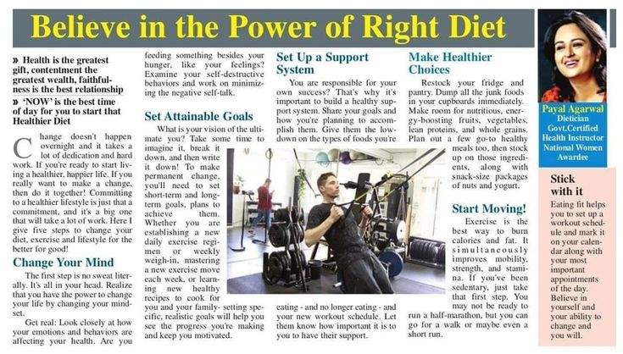
Article https://in.pinterest.com/pin/power-of-right-diet--794885402973640918/

Slide 7
How it works
First the user needs to login to use the application.
The user is connected with the dietitian and trainer to state his/her problem.
The Dietitian suggests the diets to the user according to their requirements like keto diets, low carb diets, veg ,non -veg etc.
Then the trainers trains with some exercise according to the diet plan.
We have continuous analysis of the user so that he/she can view their workout.

Slide 8
Proposed Algorithm Design Techinque
We implement stress free and effective weight loss system.
The user gets to connect with the dietitian and trainer in order to achieve fair weight loss manner.
The dietitian based on the users health conditions prepares a diet plan as it is done offline.
Even the trainer suggests workout as per the body conditions of the user.
We even maintain privacy.

Slide 9
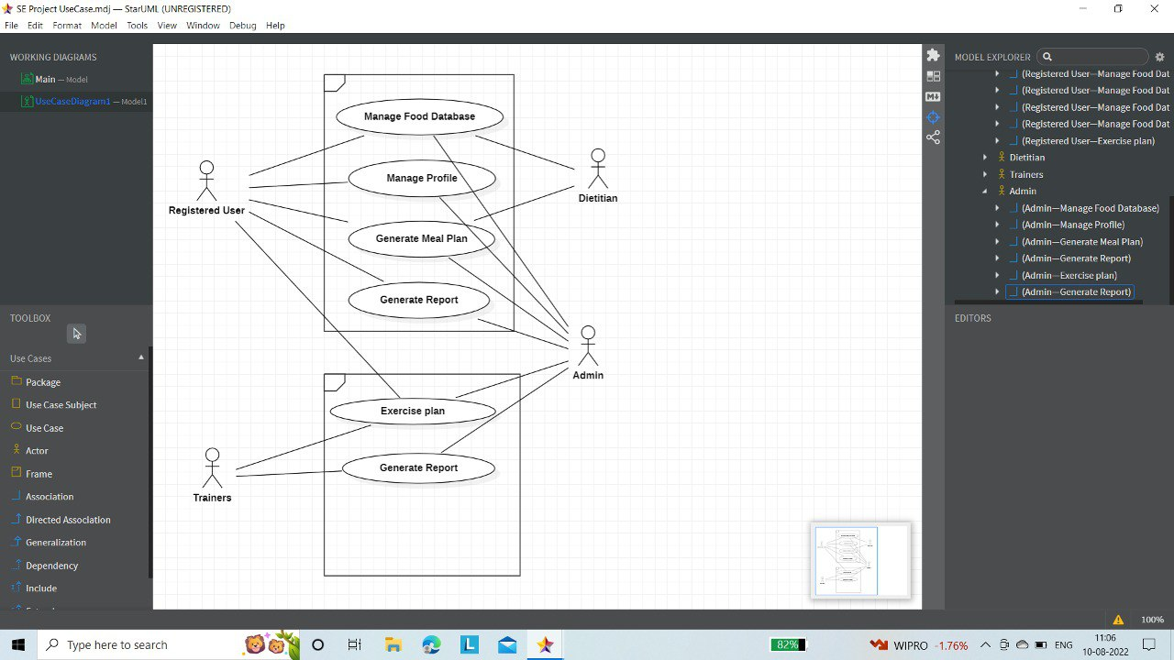
Use Case Diagram

Slide 10



Tools setup
Django
Surveys
MY SQL
Star Uml

Slide 11
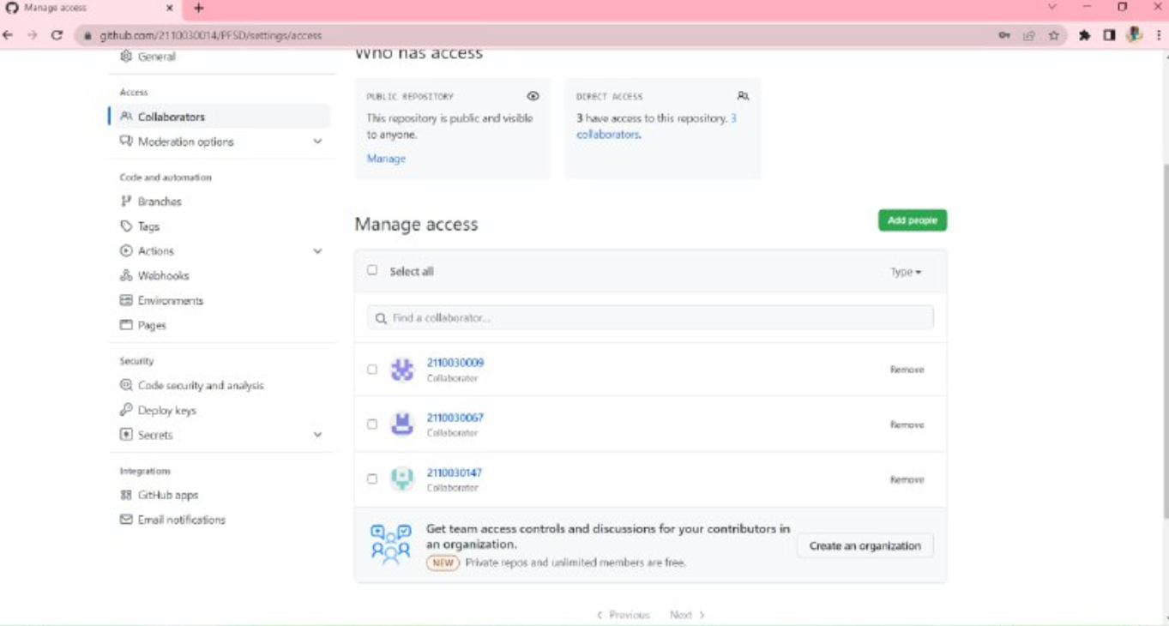
Github Setup

Slide 12
Sources
https://www.scribd.com/document/541981734/Diet-and-Workout-Assistant-DWA-2
https://healthyeating.sfgate.com/what-ate-lose-weight-noom-13771700.html

Slide 13
Division of work among the group members
2110030014 G.Haritha Maithreyee: Front end & design
2110030147 G.Mahitha Christina: Back end with DBMS
2110030009 G.Vaishnavi: Front end & design
2110030067 A.Bhavya Sri: Data set Collection

Slide 14
THANK YOU

